Slide 1
Superstore Sales & Profit Analysis: Executive Summary

Slide 2
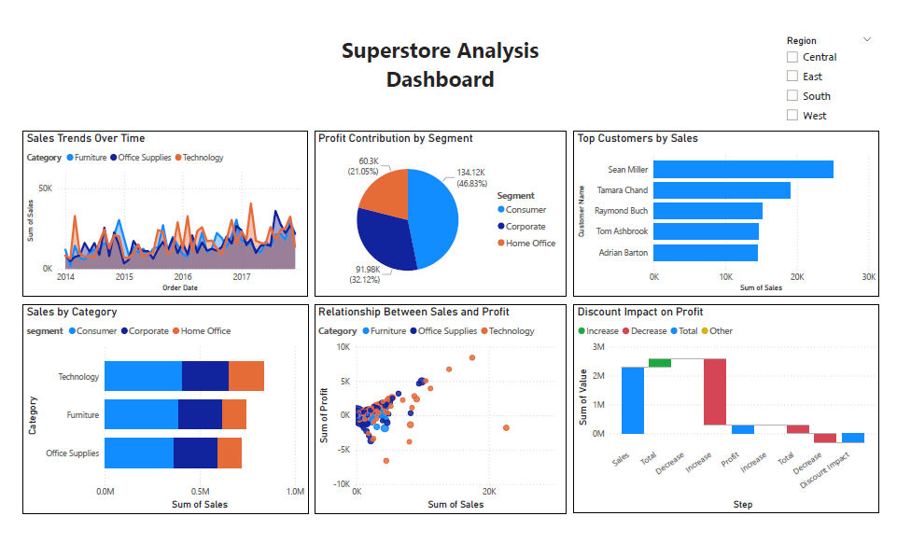

Slide 3
Overall Performance
Sales have shown a steady upward trend over the analyzed period, with the Technology category leading growth.
Profit is highest in the Technology segment, while Furniture shows the lowest profit margins.
Key Insights
Top 10 customers account for a significant share of total sales, highlighting the importance of customer retention.
Discounts have a noticeable negative impact on profit, especially in the Furniture category.
Regional analysis reveals the West region consistently outperforms others in both sales and profit.
Visual Highlights
Line Chart: Sales growth over time, with Technology outpacing other categories.
Pie Chart: Profit distribution by segment, showing Technology dominance.
Waterfall Chart: Visualizes how discounts reduce profit, particularly in Furniture.
Bar Chart: Top customers by sales, emphasizing the value of key accounts.
Recommendations
Focus marketing and retention efforts on top customers to maximize profit.
Re-evaluate discount strategies in the Furniture category to improve margins.
Leverage strengths in the Technology segment and West region for future growth.
Next Steps
Launch targeted campaigns for high-value customers.
Review and optimize discount policies, especially for Furniture.
Expand successful strategies from the Technology segment to other categories.

